Slide 1

GEOGRAPHICAL ROUTING
Subject : WSN
Name : Sneha Pawar.
Roll No : 11

Slide 2
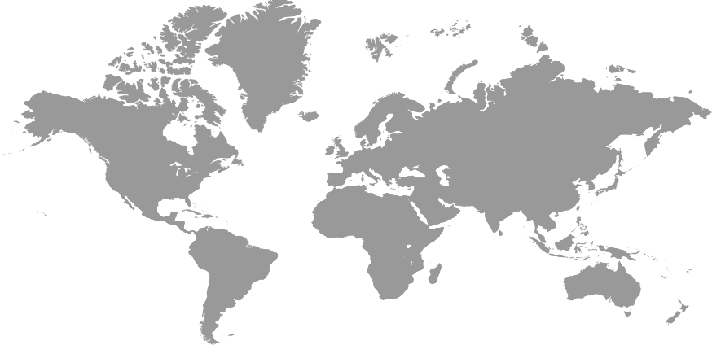
GEOGRAPHICAL ROUTING
Routing
Approaches of Routing
WSN
ROUTING TECHNIQUES
GEOGRAPHICAL
ROUTING
GATEWAY
ELECTION
TAXONOMY
How the location can be identified

Slide 3
What is WSN :
A wireless sensor network (WSN) is an infrastructure-less wireless network that is deployed in a area by using large number of wireless sensors that are used to monitor the system, physical or environmental conditions.
What is Routing :
A Routing is a process of selecting path along which the data can be transferred from source to the destination.
Routing is performed by a special device known as Router.

Slide 4
Approaches of Routing
Basically there are 2 approaches of routing.
Traditional routing algorithms (Based on topology and network traffic)
Geographical routing
When to Use Geographic Routing :
- By using geo location routing, we can localize the content of our website by using the language, Currency etc. as per the location of your users.
If you want to restrict the distribution of the content of your website only to the locations where you have distribution rights.

Slide 5
Geographical Routing
It makes use of location information in routing
In Geographical Routing each node knows the location of it’s direct neighbors..
What is Geographical Routing ?
Geographical routing or geo routing, is when the destination of a message is specified in terms of geographical coordinates.
These coordinates may be that of a given node or a particular location.
Eg., What is the Whether (Temperature, Humidity) at a given location.

Slide 6
How the location can be identified
We can know the nodes location by using :
Outdoor positioning device
GPS: Global Positioning System
Accuracy: about 5 to 50 meters
Indoor positioning device
Infrared
Short distance radio

Slide 7
The destination location is also known by using the following routing techniques:
LAR – Location Aided Routing
DREAM – Distant Routing Effect Algorithm for Mobility.
GRID Routing

Slide 8
LAR – Location Aided Routing
Location-Aided Routing (LAR) in mobile ad hoc networks
All packets carry sender’s current location.
This info enables nodes to learn of each other’s location.

Slide 9
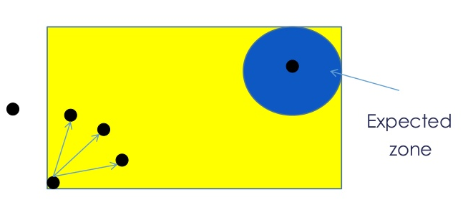
Basic idea of LAR
LAR uses location information using GPS, through which every node can know it’s current physical location.
In LAR, one node find out the route to another node when it wants to send data to that node.
Phases in LAR :
Route Discovery : To find out path from source to destination
Route Error : If any path failes, route error will be sent to sender.
Request Zone
Destination
Source

Slide 10
DREAM
A Distance Routing Effect Algorithm for Mobility (DREAM)
Dissemination of location information:
Each node periodically advertises its location ( and movement information) by flooding.
This way, nodes have knowledge of one another’s location.

Slide 11
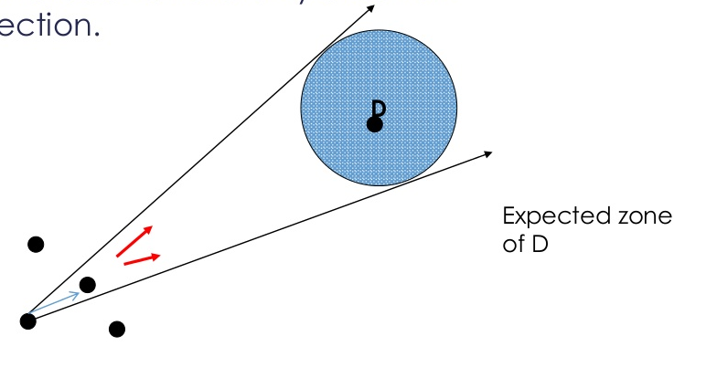
Basic Idea of DREAM
Data Packet carries 2 nodes location which came in path.
Forwarded towards only a certain direction.

Slide 12
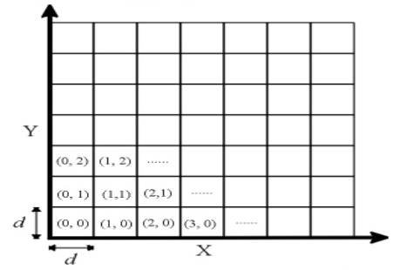
Grid Routing
“GRID: A Fully Location-Aware Routing Protocol for Mobile Ad Hoc Networks”
Partition the physical area into d x d squares called grids.

Slide 13
Protocol Overview
In each grid, a leader is elected, called gateway.
Responsibility of gateways:
Forward route discovery packets
Propagate data packets to neighbor grids
Maintain routes which passes the grid
Routing is performed in a grid-by-grid manner.

Slide 14
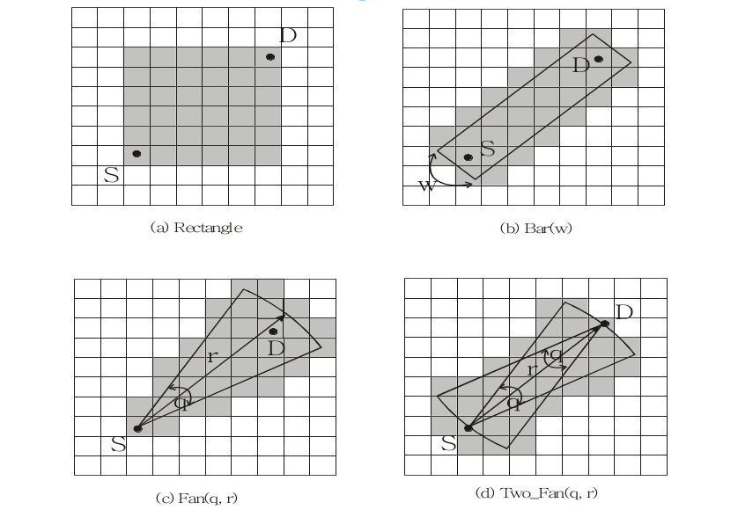
Route Search Range Options

Slide 15
Gateway election in a grid
Any “leader can be used.
Multiple leaders in a grid are acceptable.
Preference in electing a gateway:
Near the physical center of the grid
Likely to remain in the grid for longer time
Once elected, a gateway remains so until leaving the grid election protocol in distributed computing

Slide 16
Taxonomy of Geographical Routing Algorithms
Also called position-based routing
Three major components of geographic routing:
Location services (dissemination of location information)
Forwarding strategies
Recovery schemes

Slide 17
Thank You

